Slide 1
Simple Linear Regression

Slide 2
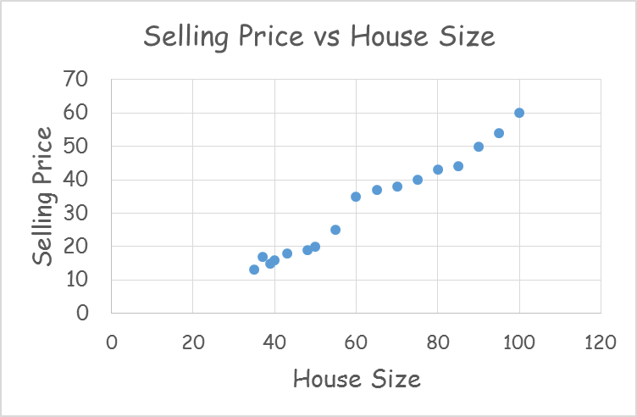
House Price Prediction
Area (SQM) | Selling Price (Lacs)
35 | 13
37 | 17
39 | 15
40 | 16
43 | 18
48 | 19
50 | 20
55 | 25
60 | 35
65 | 37
70 | 38
75 | 40
80 | 43
85 | 44
90 | 50
95 | 54
100 | 60

Slide 3
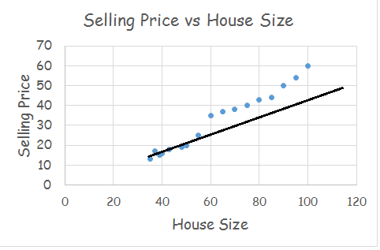
House Price Prediction
Area (SQM) | Selling Price (Lacs)
35 | 13
37 | 17
39 | 15
40 | 16
43 | 18
48 | 19
50 | 20
55 | 25
60 | 35
65 | 37
70 | 38
75 | 40
80 | 43
85 | 44
90 | 50
95 | 54
100 | 60

Slide 4
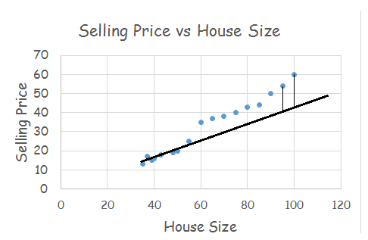
House Price Prediction
Area (SQM) | Selling Price (Lacs)
35 | 13
37 | 17
39 | 15
40 | 16
43 | 18
48 | 19
50 | 20
55 | 25
60 | 35
65 | 37
70 | 38
75 | 40
80 | 43
85 | 44
90 | 50
95 | 54
100 | 60

Slide 5
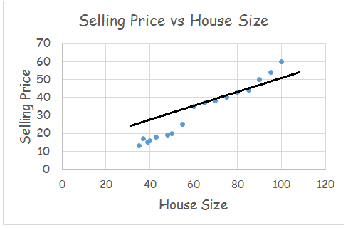
House Price Prediction
Area (SQM) | Selling Price (Lacs)
35 | 13
37 | 17
39 | 15
40 | 16
43 | 18
48 | 19
50 | 20
55 | 25
60 | 35
65 | 37
70 | 38
75 | 40
80 | 43
85 | 44
90 | 50
95 | 54
100 | 60

Slide 6
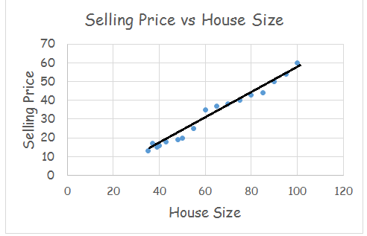
House Price Prediction
Area (SQM) | Selling Price (Lacs)
35 | 13
37 | 17
39 | 15
40 | 16
43 | 18
48 | 19
50 | 20
55 | 25
60 | 35
65 | 37
70 | 38
75 | 40
80 | 43
85 | 44
90 | 50
95 | 54
100 | 60

Slide 7
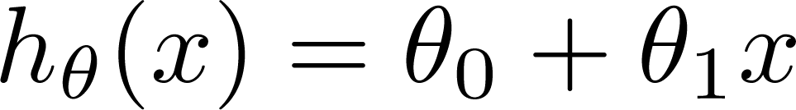
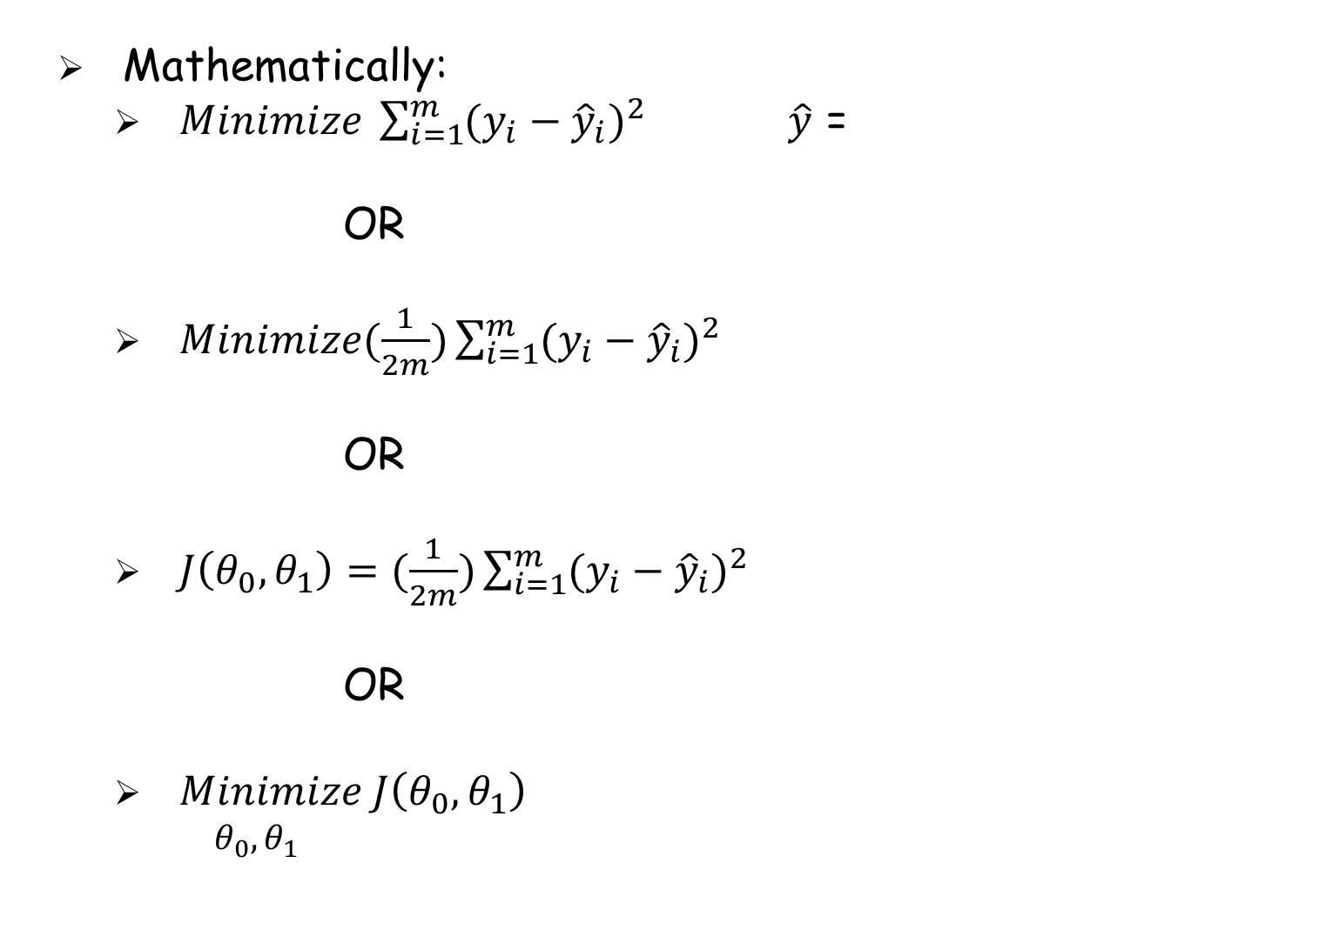
House Price Prediction
Mathematically:
$Minimize \sum_{i=1}^{m}{{(y_{i}−{\hat{y}}_{i})}^{2}}$ $\hat{y}$ =
OR
$Minimize(\frac{1}{2m})\sum_{i=1}^{m}{{(y_{i}−{\hat{y}}_{i})}^{2}}$
OR
$J\left(θ_{0},θ_{1}\right)=(\frac{1}{2m})\sum_{i=1}^{m}{{(y_{i}−{\hat{y}}_{i})}^{2}}$
OR
$Minimize J\left(θ_{0},θ_{1}\right)$
$θ_{0},θ_{1}$

Slide 8
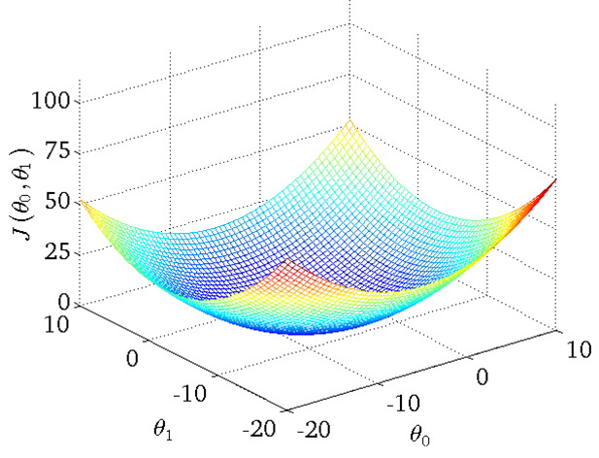
House Price Prediction
Mathematically:

Slide 9



House Price Prediction
Mathematically:
$$J\left(θ_{1}\right)$$
at local optima
Current value of

Slide 10
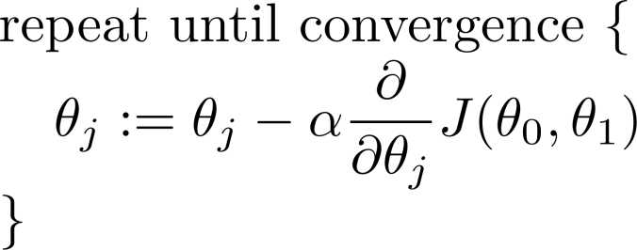
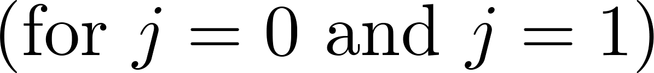
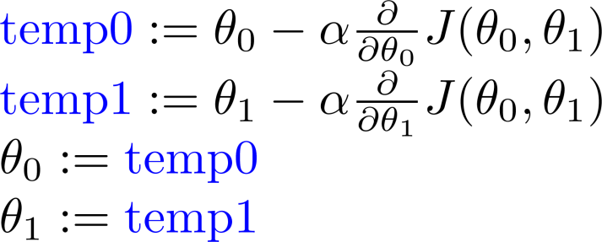
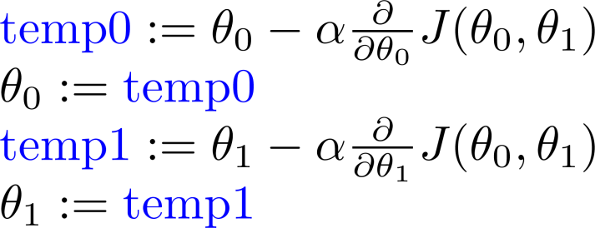


House Price Prediction
Gradient Descent Algorithm
Correct: Simultaneous update
Incorrect:
=

Slide 11
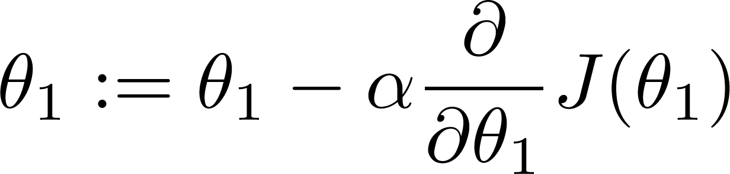
If α is too small, gradient descent can be slow.
If α is too large, gradient descent can overshoot the minimum. It may fail to converge, or even diverge.

Slide 13
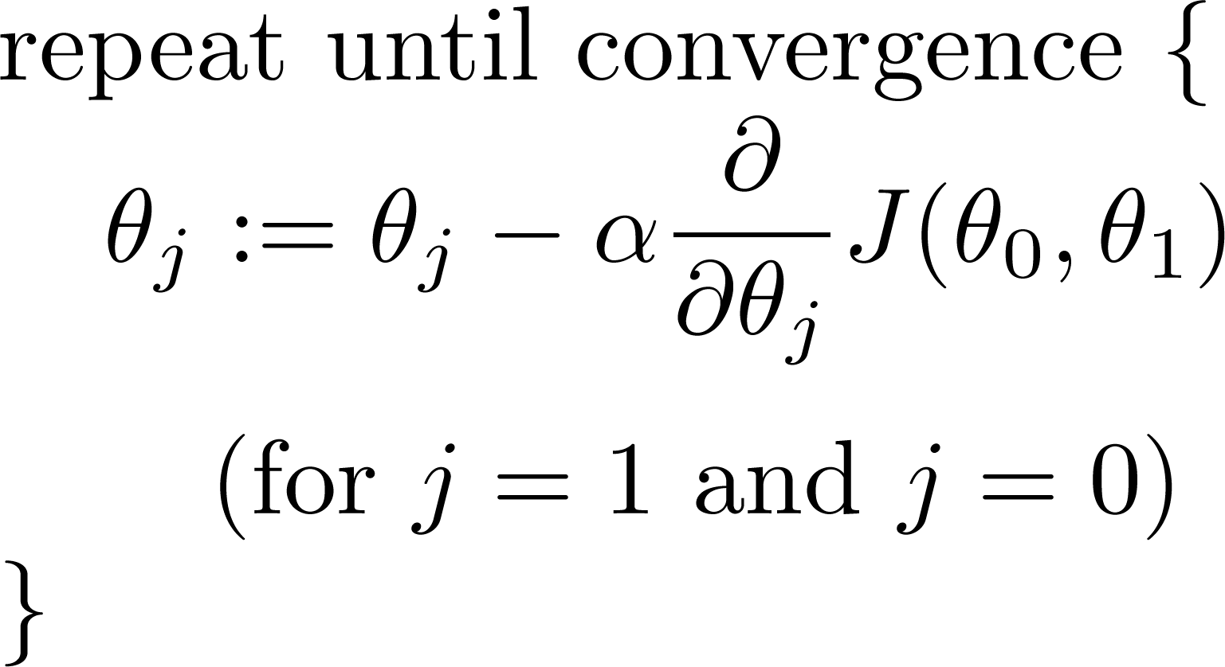
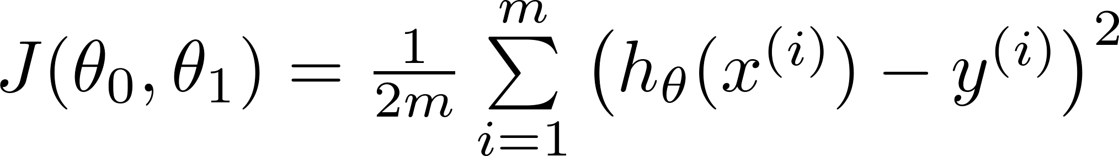
House Price Prediction
Gradient Descent Algorithm
Gradient descent algorithm
Linear Regression Model

Slide 14
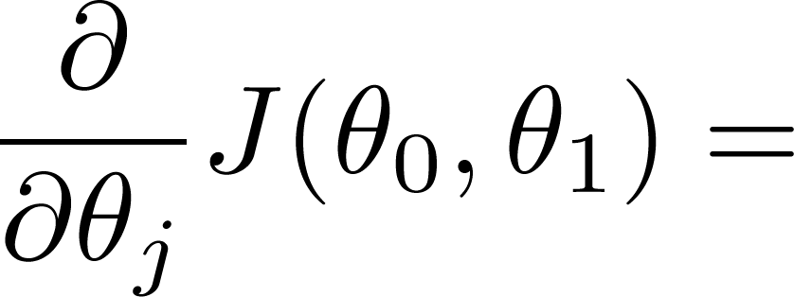
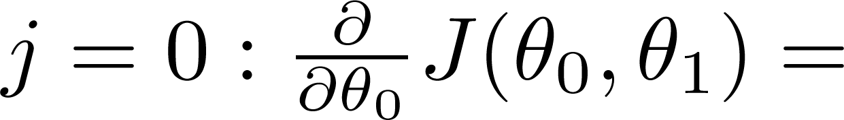
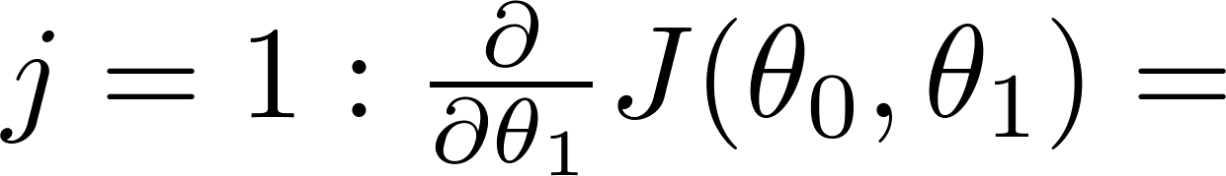
House Price Prediction
Gradient Descent Algorithm

Slide 15
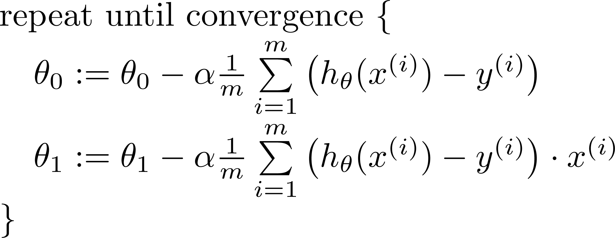


House Price Prediction
Gradient Descent Algorithm
Area (SQM) | Selling Price (Lacs)
35 | 13
37 | 17
39 | 15
40 | 16
43 | 18
48 | 19
50 | 20
55 | 25
60 | 35
65 | 37
70 | 38
75 | 40
80 | 43
85 | 44
90 | 50
95 | 54
100 | 60
update
and
simultaneously
=
If $θ_{0}$ = 1 and $θ_{1}$ = 0.5 ?

Slide 16
“Batch” Gradient Descent
“Batch”: Each step of gradient descent uses all the training examples.

Slide 17
References
Andrew Ng’s slides on Linear Regression from his Machine Learning Course on Coursera.

Slide 18
Disclaimer
Content of this presentation is not original and it has been prepared from various sources for teaching purpose.

